Slide 1

High Assurance Cloud Compute and Storage
S21 Team Ironware Final Presentation
Sponsors:
National Security Agency
Joshua Cline
Eric Darko
Jason Smith
Team Members:
Khalid Abusultan
Chetan Garikapati
Monish Alur Gowdru
Giakhanh Hoang
Travious Lewis

Slide 2
Overview
With an increasing adaptation of containers, there is a growing need for solutions to securing containers and their data
Our goal:
Research container exploits
Review existing container hardening solutions/techniques
Develop a comprehensive approach to securing containers and their data
Notes:
Securing data also includes data sanitization

Slide 3
Progress
Investigated vulnerabilities in Docker
Developed a secure data storage solution for the cloud
Interviewed a security expert

Slide 4
What is a container
A lightweight solution to packaging an application's environment altogether for easy testing and development
  Examples: Docker, Kubernetes
Hosted on servers within operating systems
  May be configured to access the host's resources
Can communicate with other containers
Notes:
An application's environment includes a guest OS and any other environmental variables.
A host's resources include hardware resources like the CPU/GPU, or even the host file system if configured to do so.
It pretty much is a abstract, condensed package to serve as a component for a larger system/as part of a scalable system.

Slide 5
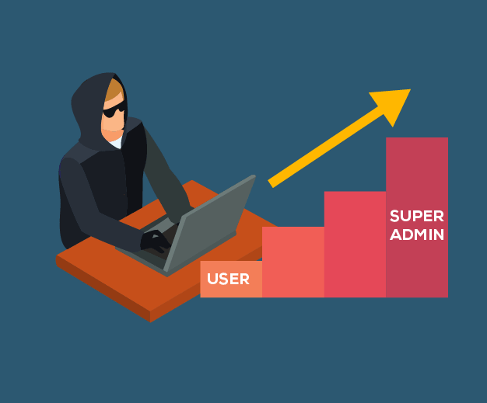
PRIVILEGE ESCALATION
Obtaining access to restricted resources from unprivileged account by exploiting weakness, design flaw or configuration oversight.
A user with more privileges than intended can perform unauthorized actions.
Vertical Escalation is where the attacker gains more access than the user they have compromised.
Horizonal Escalation is where the attacker expands their privileges by taking over another account and misusing it.

Slide 6
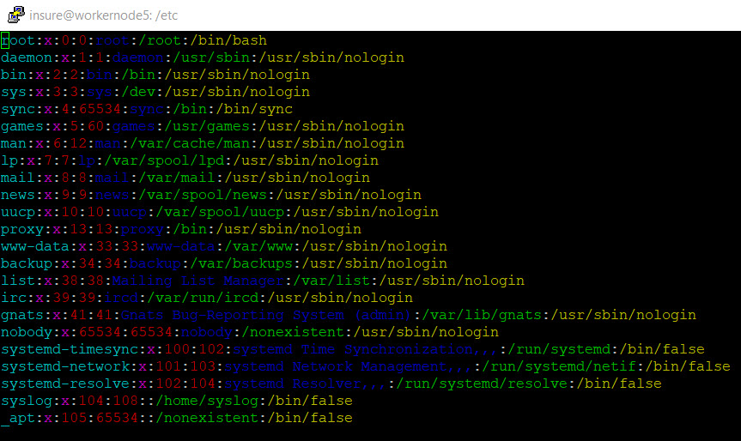

gaining root access
A root user in docker has a default user id of 0. A malicious user could take advantage of this by messing with the passwd file in the homeroot/etc directory.
A malicious user named foo will be added to the docker group and will login.
The malicious user created in docker will now try to mess with the passwd file and change their user id to 0 (such as root) .
Foo is currently running as a normal user.

Slide 7
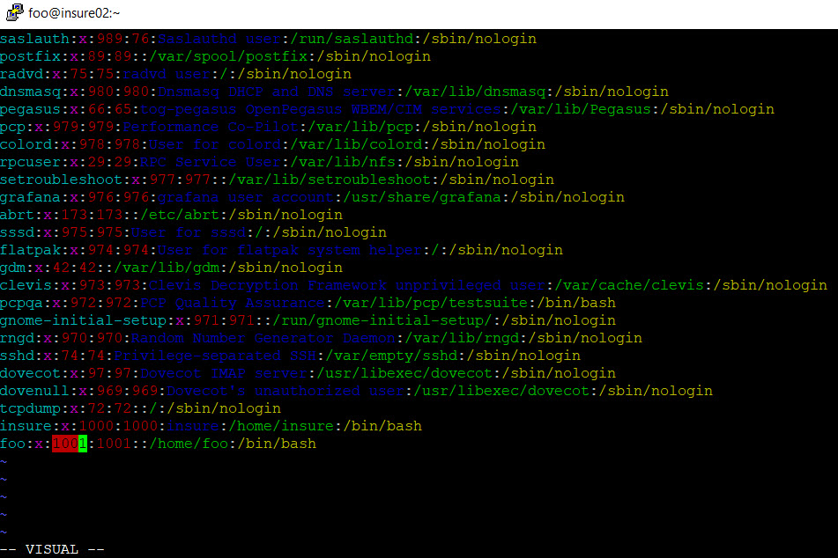
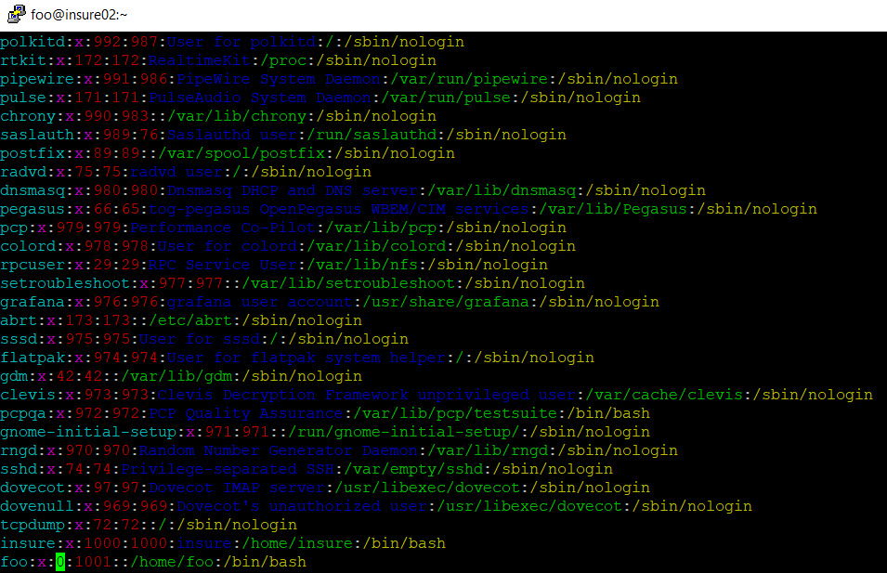
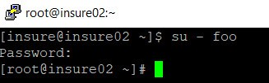
GAINING ROOT ACCESS (CONTINUED)
The malicious user foo changed their user id from 1001 to 0 (such as root)
Now foo exists and logs out then logs in back they will have full root privileges and will run as root

Slide 8

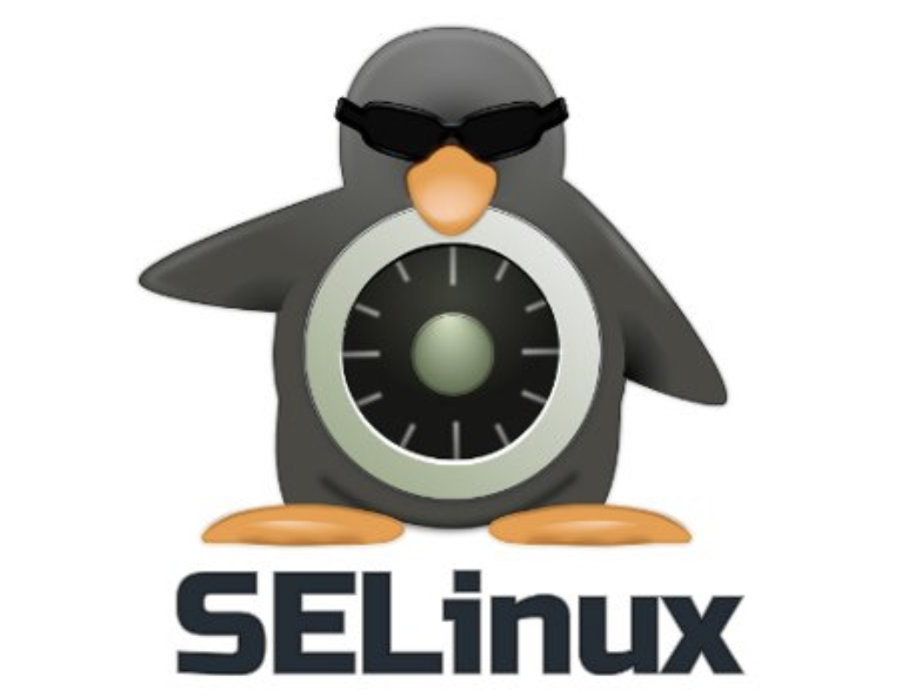
Running SELinux
Linux hardening techniques can be used on docker (Docker is based on Linux container)
Make sure SELinux is always running with containers by this command "sestatus"
Below are some of the techniques with SELinux that can be used to prevent the vulnerability
  Do not run privileged on containers
    It is not necessary to have every user by default to run on privileged
    Use "--security-opt" for containers instead which is compatible with SELinux/AppArmor

Slide 9
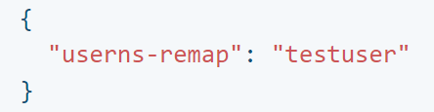
Docker Namespace Remapping
Namespaces allow for processes to run in an isolated environment
Good way to combat against privilege-escalation attacks
Still exists an exploit that allows a container root access to the host
Add to /etc/docker/daemon.json file

Slide 10

Docker Privileged mode
Containers running in priveleged mode receive root capabilities of host machine.
Container is able to create and modify files on the host.
Also can mount file systems and create new devices
This mode makes the system vulnerable to malicious attacks
Enabled with "-- privileged" flag
  $ sudo docker run -itd --privileged --userns=host --pid=host --network=host ubuntu bash

Slide 11
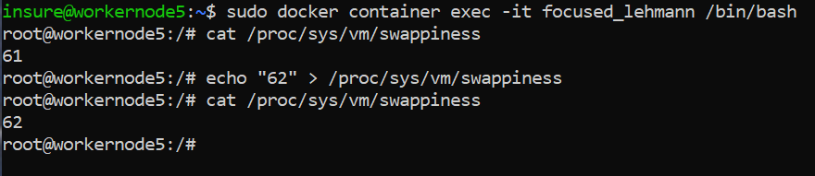
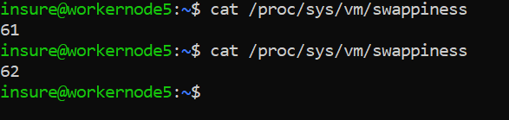

Slide 12
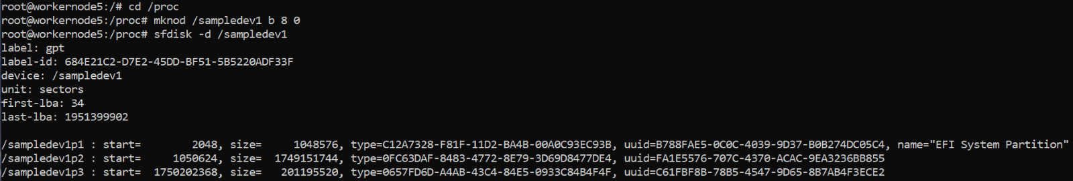
Privileged container successfully creating a new device file.

Slide 13
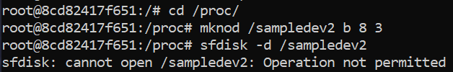
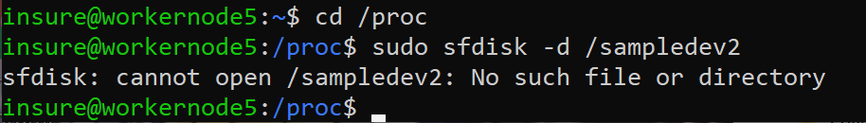
Unprivileged container does not have the capability to create a new device.

Slide 14
Authorization Plugins
One way to combat the namespace remapping vulnerability is to not use privileged containers entirely.
Only give a container specific capabilities needed to perform functions effectively
  docker run –cap-add
What if an unauthorized user runs a container in privileged mode?
Authorization plugins
  .

Slide 15

Progress on Cloud Data Sanitization
1. Cloud based Data-Storage Sanitization
1
2. Risks associated and incidents
2
3
3. Standards for sanitization
5. Implementation
4. Cryptographic erasure
4
5

Slide 16
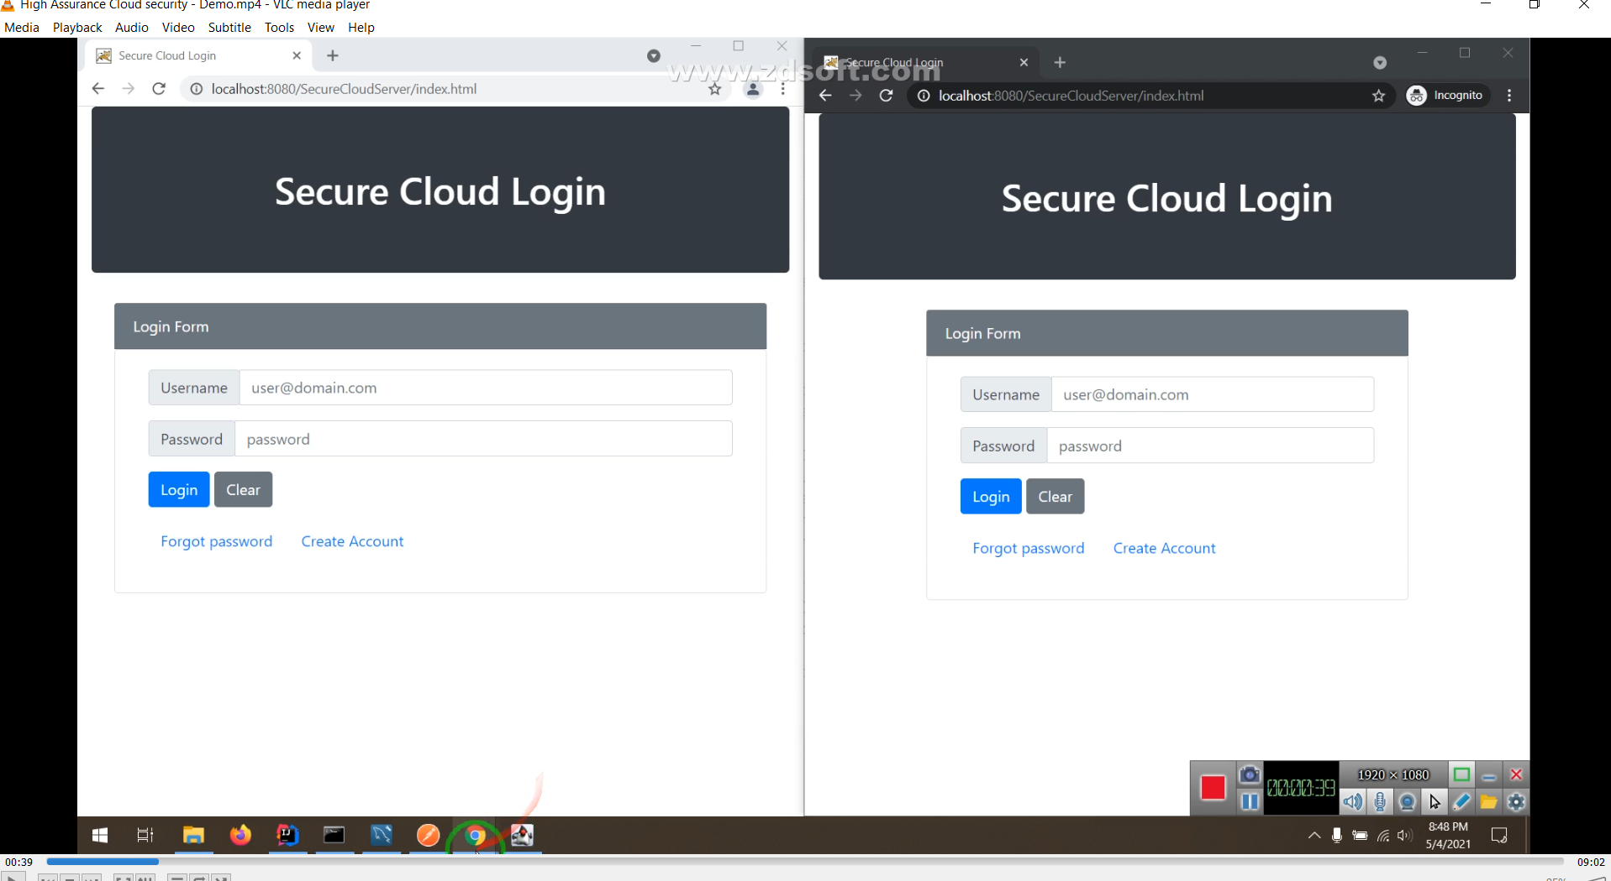
Implementation Demo
Video Link - https://drive.google.com/file/d/1m1BtMBcMq9zea5KSPBiZK3x5gxKGerqD/view?usp=sharing

Slide 17
Future SCOPE
Experiment more on implementing Linux hardening techniques using Docker and RedHat OpenShift
More research into cloud data storage sanitization techniques
  Integrated levels of file sharing
Data Storage Sanitization
  Try to build a technology to solve the problem to improve efficiency of data sanitization.
  Develop the prototype further and implement integrity models.

Slide 18
REFERENCES
("CVE-2019-15752 : Docker Desktop Community Edition before 2.1.0.1 allows local users to gain privileges by placing a Trojan horse docker-c", 2021)
("CVE -CVE-2021-21284", 2021)
("Docker userns-remap and system users on Linux", 2021)
https://docs.docker.com/engine/security/apparmor/
https://docs.docker.com/engine/security/userns-remap/
https://docs.docker.com/engine/extend/plugins_authorization/

Slide 19

Thank you!
Any Questions ?

